Slide 1
Classification using CNN
Lalit Jain https://www.linkedin.com/in/lalit7jain/
Rohit Agarwal https://www.linkedin.com/in/rohitag04/
Shivam Goel https://www.linkedin.com/in/goelshi/
Hina Gandhi: https://www.linkedin.com/in/hina-gandhi-52834356/
Big Data & Engineering Systems
Under the guidance of Professor. Dino Konstantopoulos

Slide 2
Agenda
Case Study
Building a Convolutional Neural Network
Time Complexity
Using VGG16 model
Limitations & Challenges
Future Scope
Demo

Slide 3

Case Study
Building a CNN model which can be trained on the fly and classify objects

Slide 4
Approach
Using Flickr API download the images from the front end
Prepare the image by cleaning and augmentation
Train the model based on the image downloaded with Convolutional Neural Network using Keras and Tensorflow
Classify the image
Technology Stack:
Programming Language: Python
Front End: Django Framework
Machine Specifications:
Libraries: Keras, Tensorflow, VGG16, etc

Slide 5
Data Set Description

Slide 6
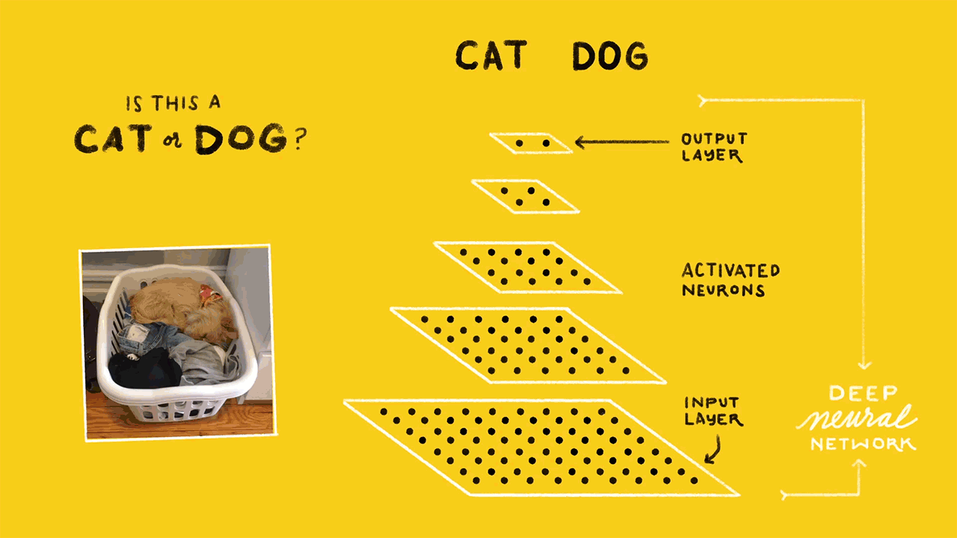
Convolutional Neural Network

Slide 7



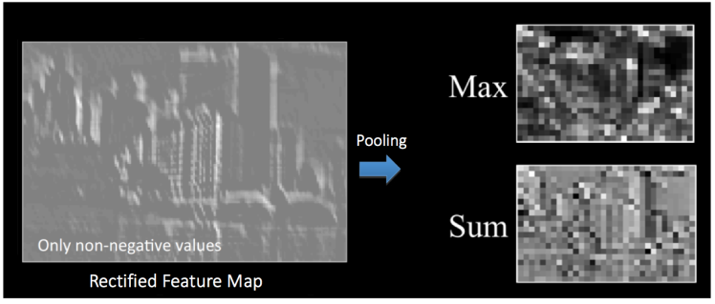
Images are a matrix of pixel values
Convolution Operation
Relu Activation
Pooling (Max)

Slide 8
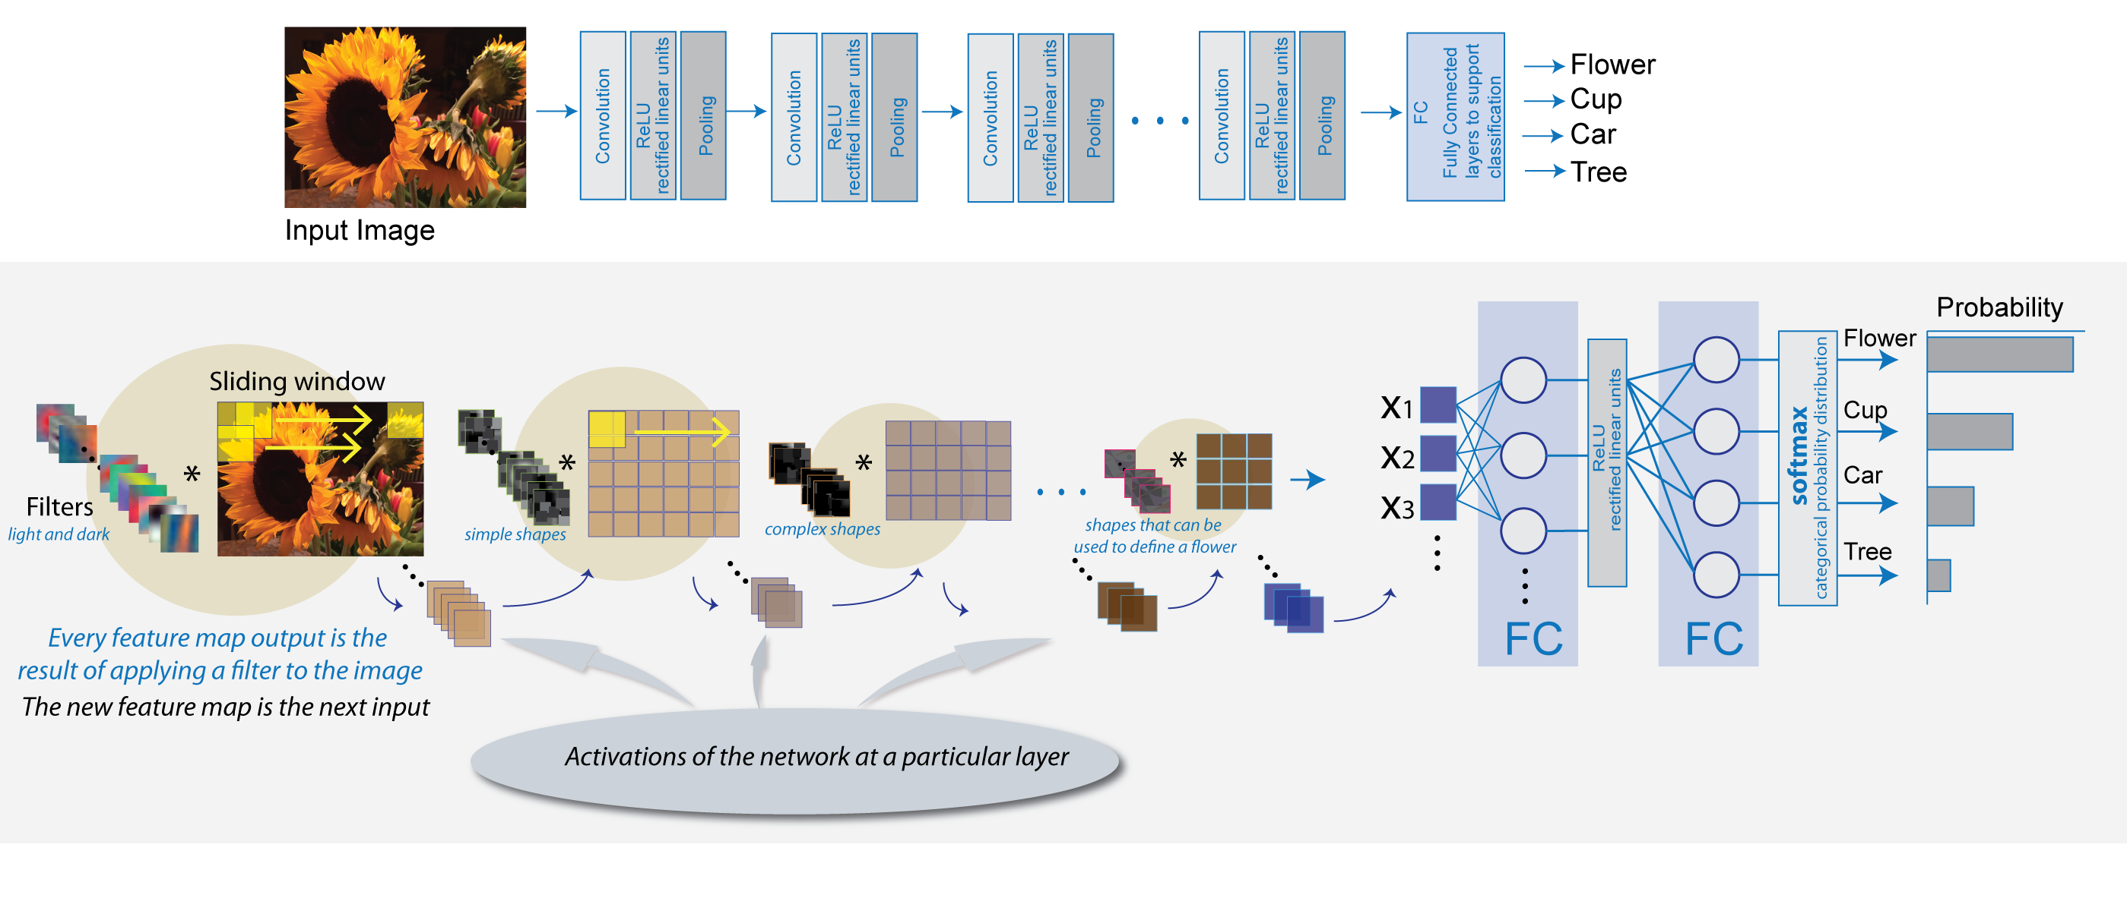
Putting it all together

Slide 9
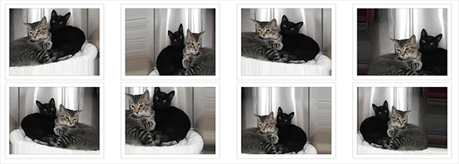
Data augmentation for improving the model
By applying random transformation to our train set, we artificially enhance our dataset with new unseen images.
shear_range: Rotate image by 0.2
zoom_range: Zoom the image by 0.2
horizontal_flip: Randomly flip inputs horizontally.
rescale: rescaling factor (1./255)

Slide 10
CNN complexity

Slide 11

VGG16 Pre-Trained Model
The model achieves 92.7% top-5 test accuracy in ImageNet, which is a dataset of over 14 million images belonging to 1000 classes.
Citation:
https://arxiv.org/pdf/1409.1556.pdf

Slide 12
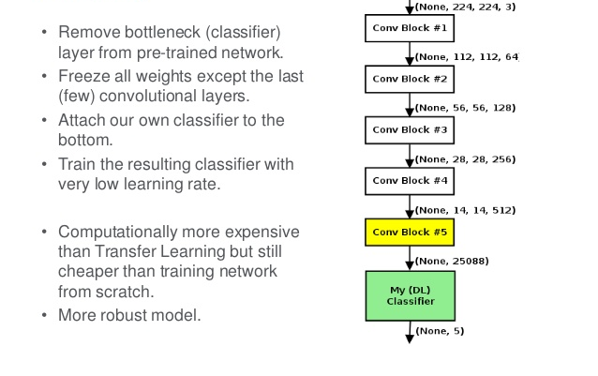
Fine tuning the VGG16 Model

Slide 13
Thank You
References:
https://districtdatalabs.silvrback.com/modern-methods-for-sentiment-analysis
https://www.zybuluo.com/HaomingJiang/note/462804

